Slide 1
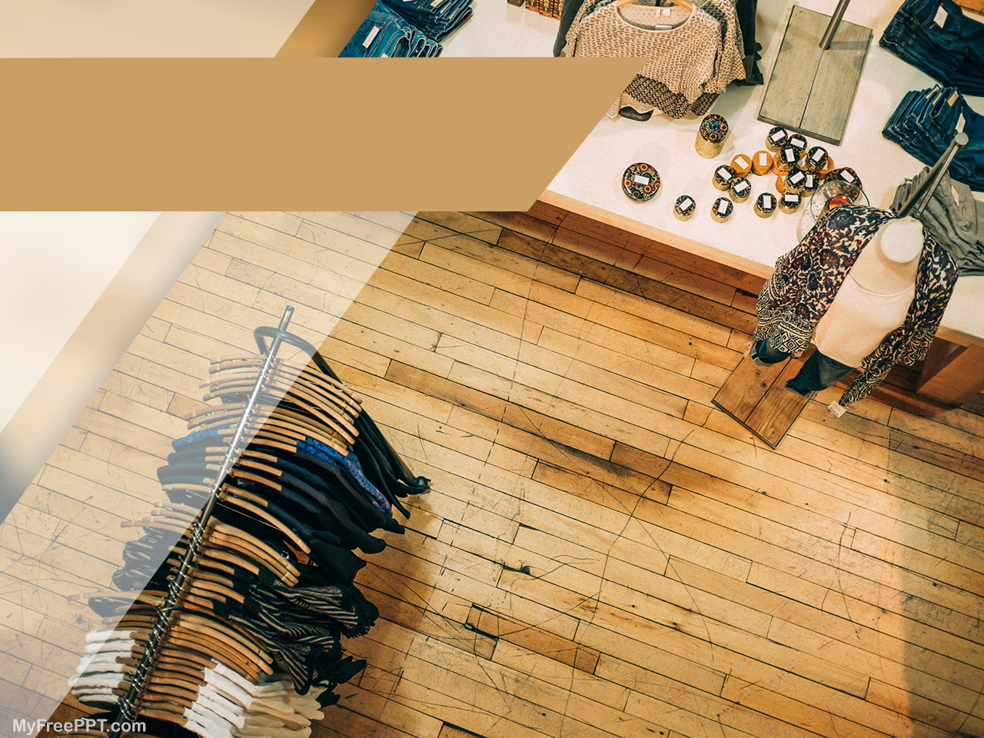
Domain Specific Content Based Image Retrieval (CBIR) for Feminine Textile Designs
Group Members :RIMSHA MALIK
AND
ANIQA MASOOD

Slide 2
Problem Statement
If we talk about content retrieval through visual searching in fashion and textile industry, we know that it have immense graphical details in it and cannot be explained correctly via text. But converting color and texture into a machine understandable pattern is another challenge.
To do so, we divide our problem into three steps:
1-we trained a deep learning model “Faster RCNN” which detect
a person from a query image.
2- Once the person is detected from image, then ROI is extracted
which is basically a patch of a cloth.
3-Now from this patch color estimation and texture classification is done.
At the end, on the basis of color and texture the most visually similar images from the database are retrieved.

Slide 3

Feminine Textile Industry
Business Need
1-The Pakistan textile industry contributes more than 60%(US $ 9.6 billion) to the country’s total exports.
2- And when we talk about online shopping we know that choosing the right product when it comes to fashion is toughest task and time consuming .
3- This industry is billionaire market and without smart vision , retrieval of the most visually similar content is not possible.

Slide 4
Objectives
Choosing the right product when it comes to fashion is the toughest task and time consuming. And when it comes to online shopping there are more than usual products in any provided store. The main objective of this work is to extract the best possible details from textile images and search for the possible outcomes from database. Following are some useful products which can be developed by using this approach:
Searching for garments: when the feature of visual searching is added in any clothing website, it is easy for a customer to locate similar product in stock of that particular brand. It also save time.
Automatic Report Generation: Color and texture extraction from images can help in maintaining reports about each collection launch by a brand. This may help designers in identifying which color combinations and textures are mostly liked by people and should be focused in near future.
Used for identifying market trends: The market trends about color and textures can be determined by getting the visual information about competitors and find out how similar and different our designs are from others. This may help us in improving our strategies and designs as well.
Use for suggestions: This system can also be used as a suggestion system. User who is searching for similar type of dresses again and again which is perceive by a system. Next time when user visit a website they will get the products according to their previous searches.

Slide 5
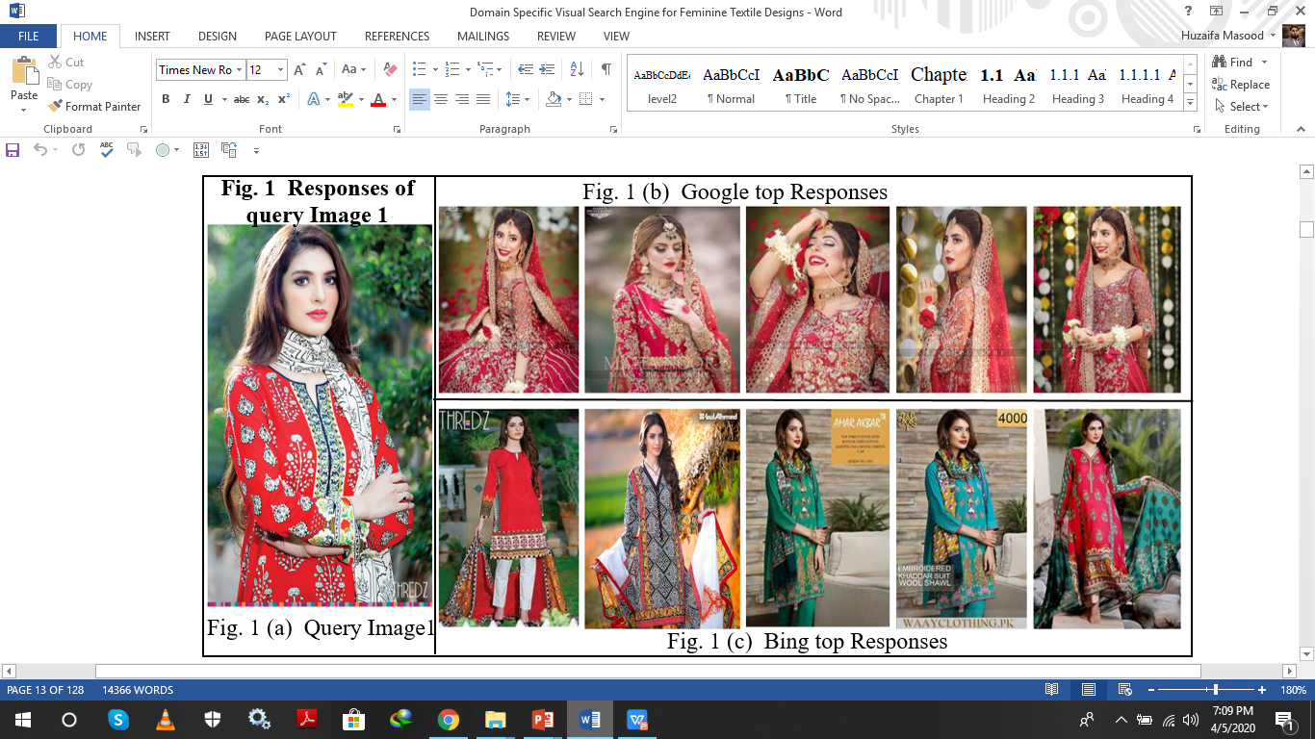
Top Search Engines Response

Slide 6
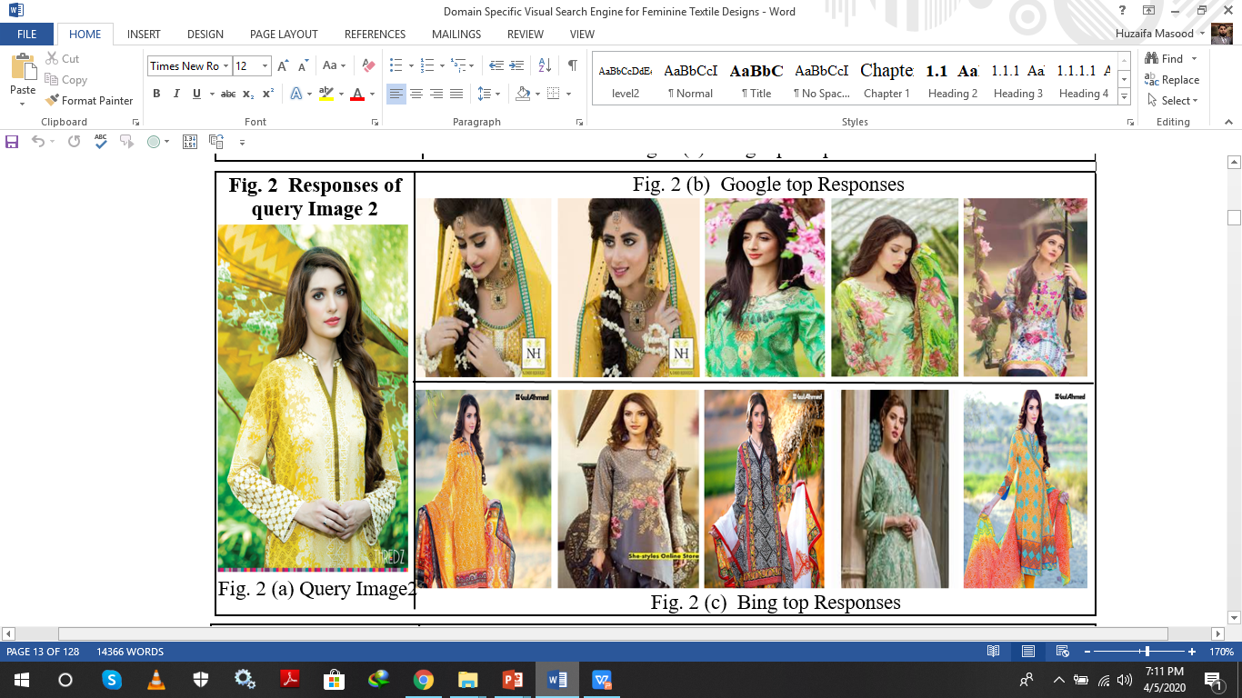

Slide 7
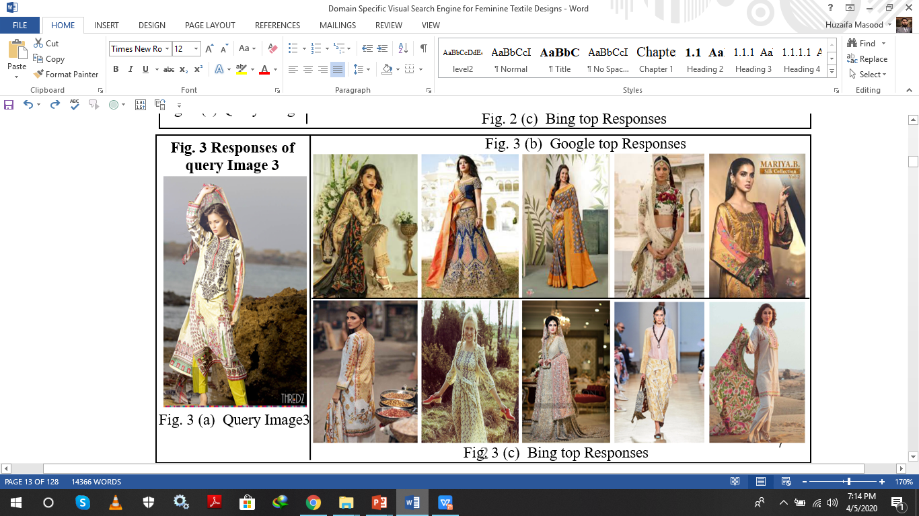

Slide 8
What we conclude From above Google and Bing Results??
Many search engines provide the facility of visual searching but the results are not up to the mark. For a while, imagine you are looking for particular fashion trend, color combination and pattern in clothing with a sample query image shown in Figure 1(a). The query image is taken from international textile brand THREDZ ; which operate mainly in Asia and USA. The model wore traditional Pakistani dress called “ Shalwar Kameez ” mainly in red and off white. The base of the fabric is filled with some black and off white flowery texture. The Tin Eye search engine perform pixel matching and did not able to find any single match for the given query image. Bing, instead of recognizing the color or pattern correctly, it does person’s face recognition in many cases ,See Figure 1(c). In comparison to Bing; Google returns with excellent responses shown in Figure 1(b) and is able to apprehend visual properties of textile. It is important to note that Google Image Search handles various other attributes including back ground, pose and hair style along with color. But even then the top Google responses gave least priority to motif color and pattern reflecting immense need for domain specific image retrieval. Color ambiguity is evident from red dress retrievals in Google responses while texture and design ambiguity seems more critical. Search results gets worse when query image comprised of outdoor scene as shown in Figure .

Slide 9
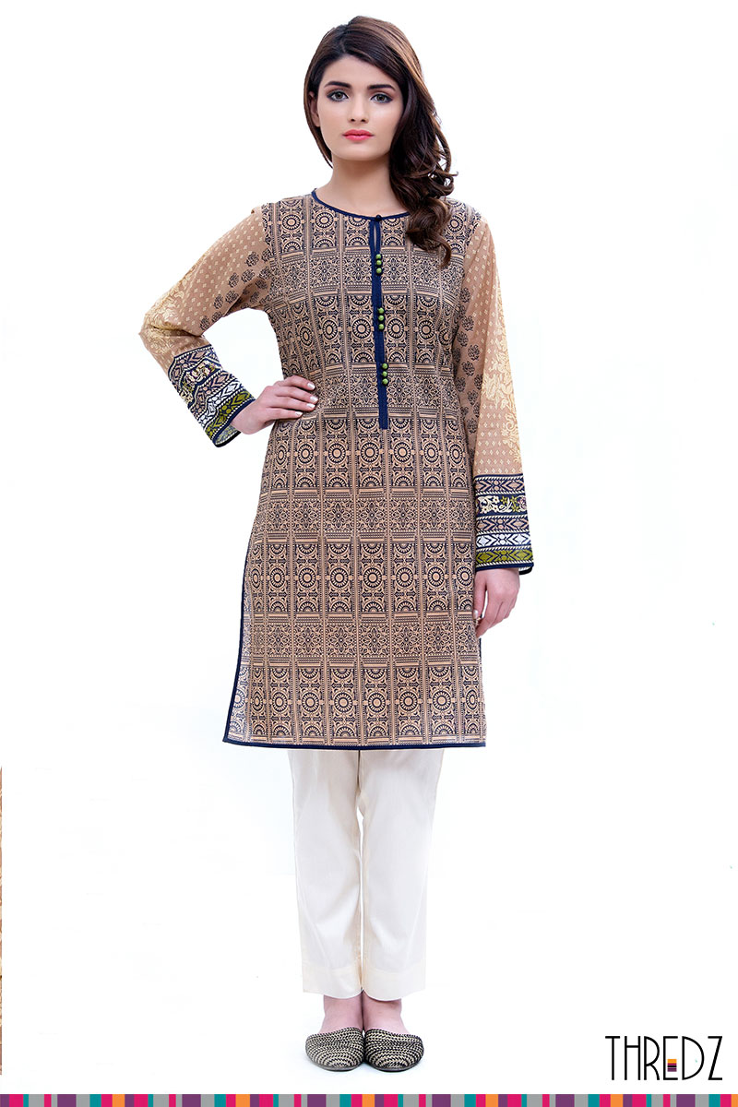
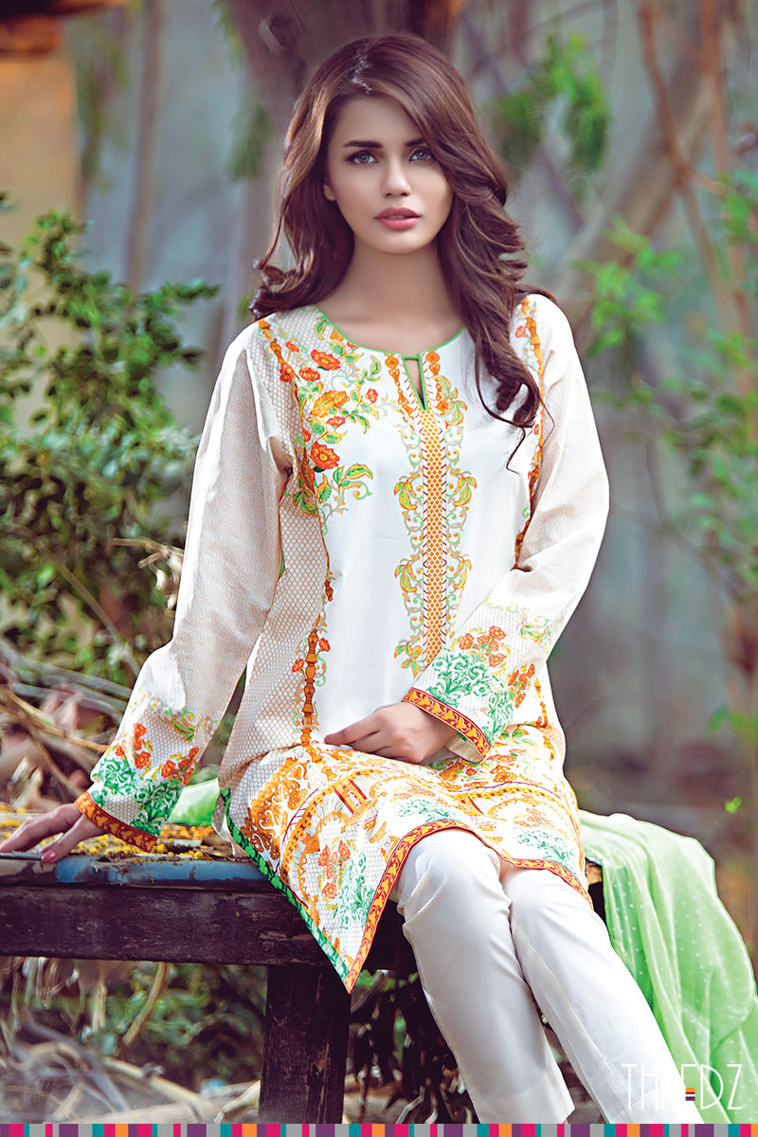
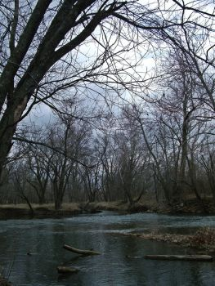

SAMPLE IMAGES FROM DATASET
QUERY IMAGE WITH SIMPLE BACKGROUND
QUERY IMAGE WITH COMPLEX BACKGROUND
NEGATIIVE QUERY IMAGE
PERSON IMAGE FROM INRIA DATASET

Slide 10
ALOGORITHM DESCRIPTION

Slide 11
DATA PREPROCESSING
For the purpose of training a model for human detection, we need annotations .
The format for annotation file is “filename , class_type , x1 , x2 , y1 , y2 ”.
where,
filepath is the path of the training image.
x1 is the xmin coordinate for bounding box.
y1 is the ymin coordinate for bounding box.
x2 is the xmax coordinate for bounding box.
y2 is the ymax coordinate for bounding box.
class_name is the name of the class in that bounding box.
Hence we need bounding box coordinates for training images. For this we use “LARGEST BLOB DETECTION METHOD”.As this method works on white background so all the images are preprocessed via Adobe Photoshop. After largest blob detection the coordinates of bounding boxes are identified from which csv file and then annotation file is prepared.
Steps For Largest Blob Detection :
1- Load image.
2-Convert to grayscale.
3-Blurring for removing the noise.
4-Threshold the image .
5-Find the contour of the figure.
6-Find the biggest area of the contour.

Slide 12
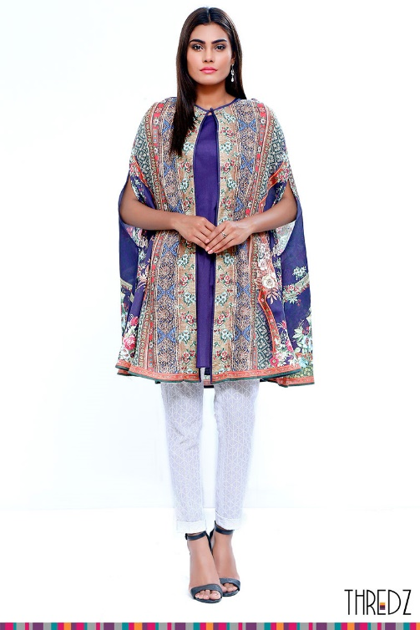
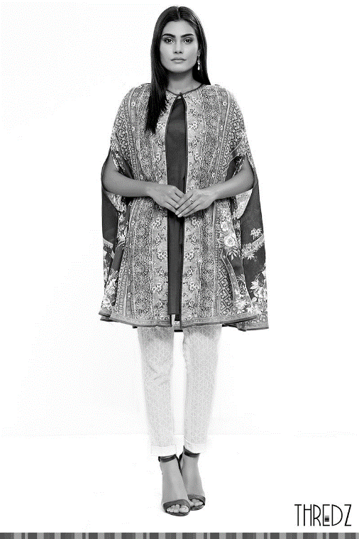
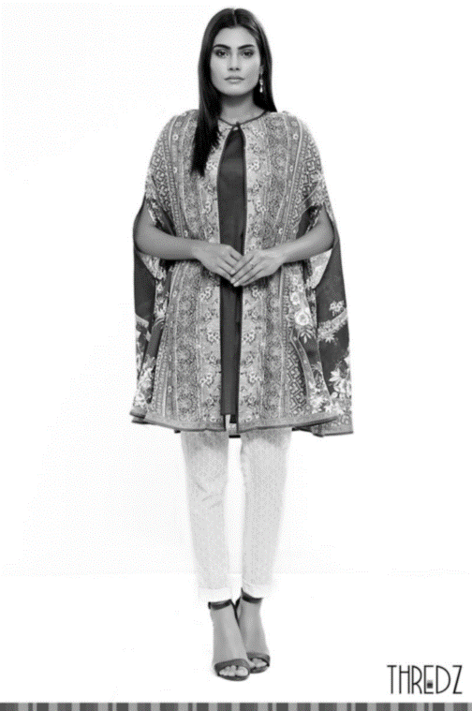
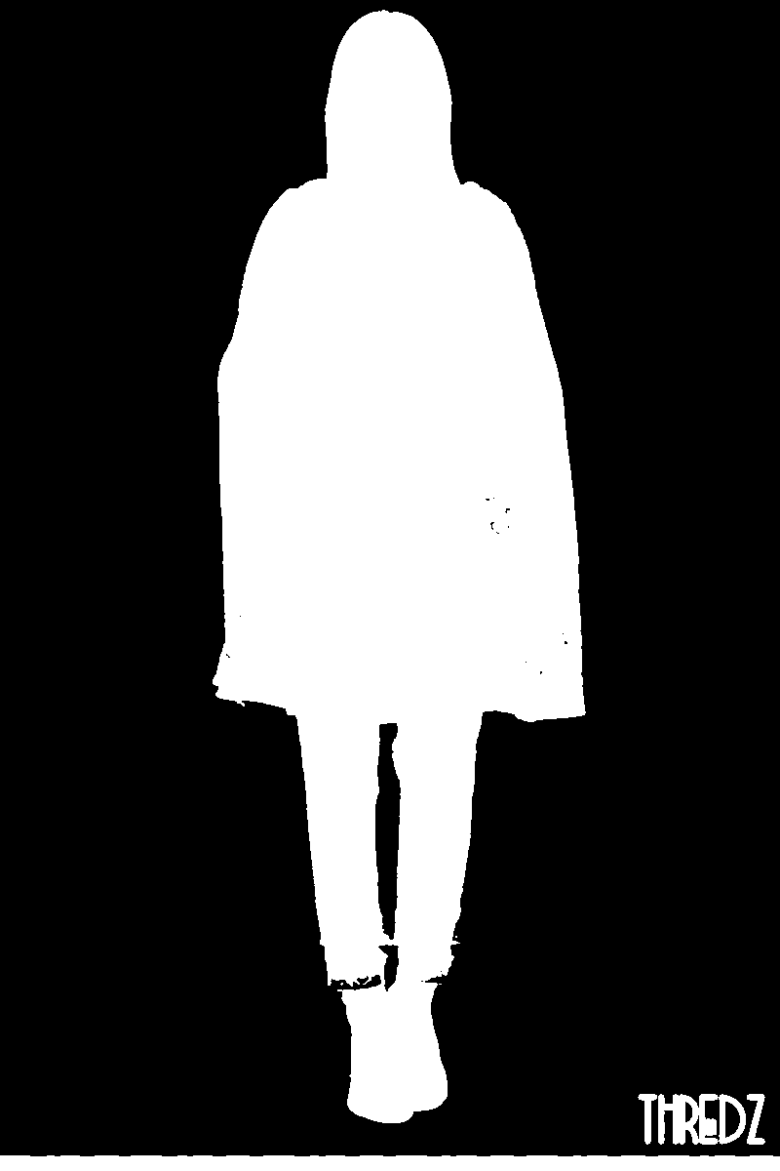

FLOW DIAGRAM OF DATA PRE-PROCESSING
Image
Convert to grayscale
Blurring for removing
the noise
Threshold the image
Find Bounding box
co-ordinates
of the image

Slide 13
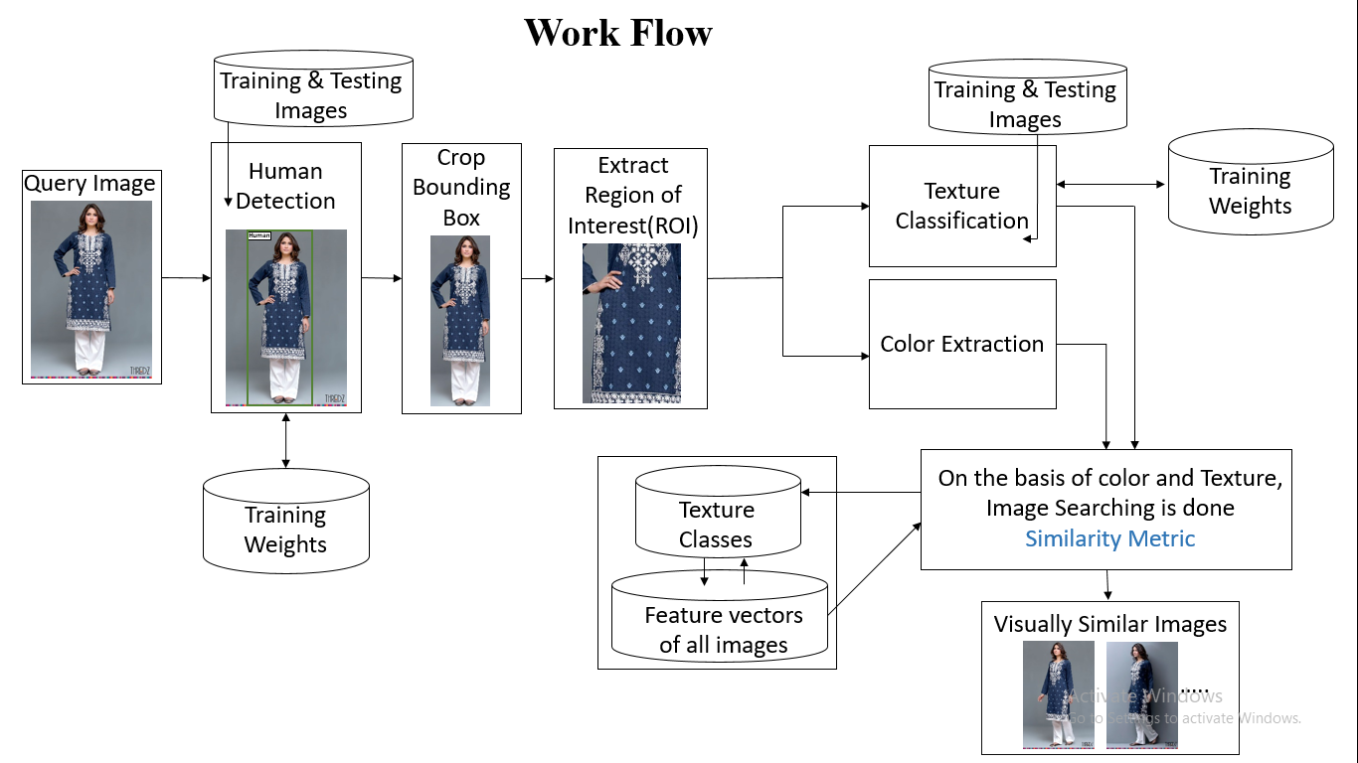
FLOW DIAGRAM OF OUR SEARCH ENGINE

Slide 14
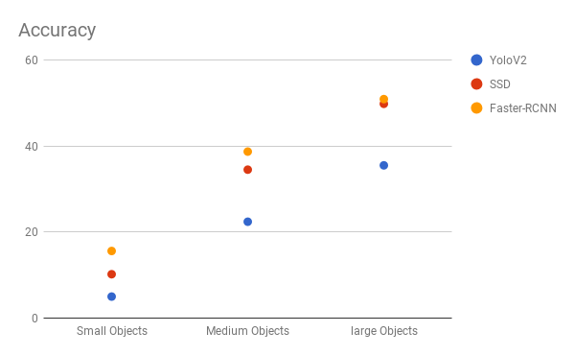
MODULE#1 “HUMAN DETECTION”
Different Deep Neural Networks,
Why we choose Faster R-CNN??

Slide 15
Architecture of Faster RCNN,
Mapped on our Problem:

Slide 16
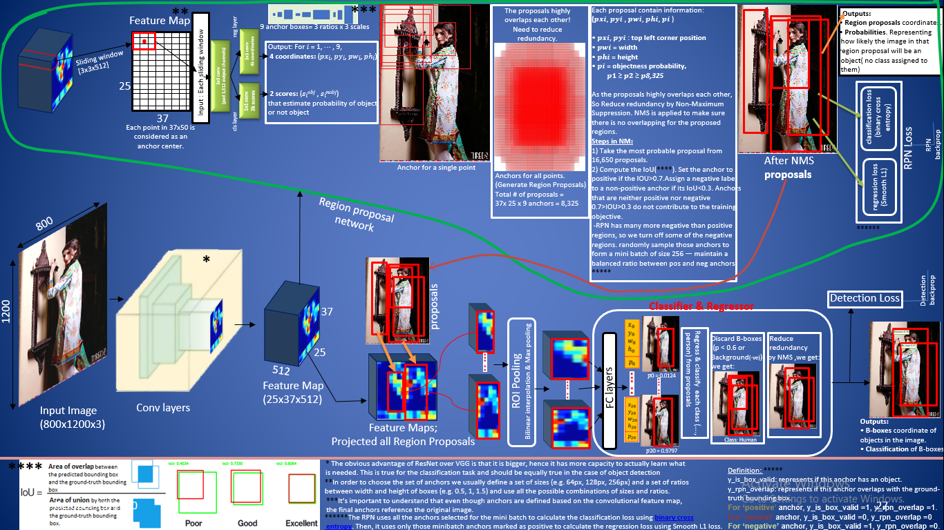

Slide 17
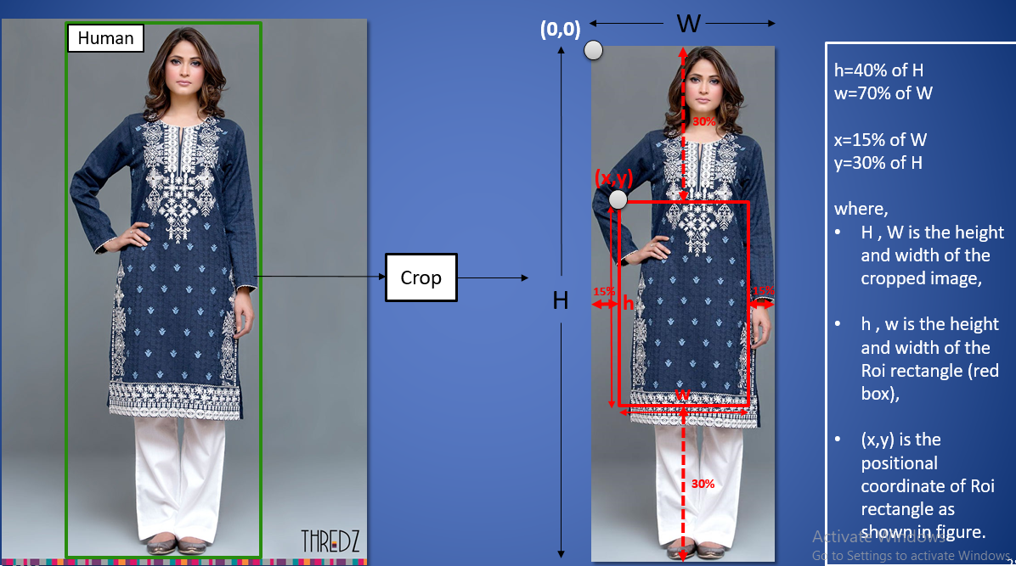
“CROP & ROI CALCULATION”

Slide 18
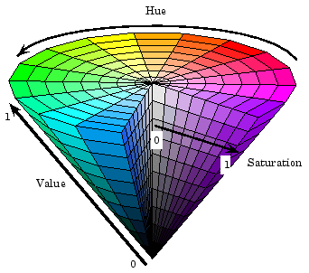
MODULE#2 “COLOR EXTRACTION”
3D HSV HISTOGRAM
Hue, Saturation, and Value (HSV) is a color model
In which
1-Hue represent actual color or the dominant one
in an image such an blue , red , green or yellow .
2-Saturation represent the intensity of the color,
How light and dark the color is or we can say that
presence of color white in an image . Darker the
color , more will be saturation value .
3-The term value correspond to the brightness or
luminance factor present in the image.
HSV may also be called HSB (short for hue, saturation and brightness).

Slide 19
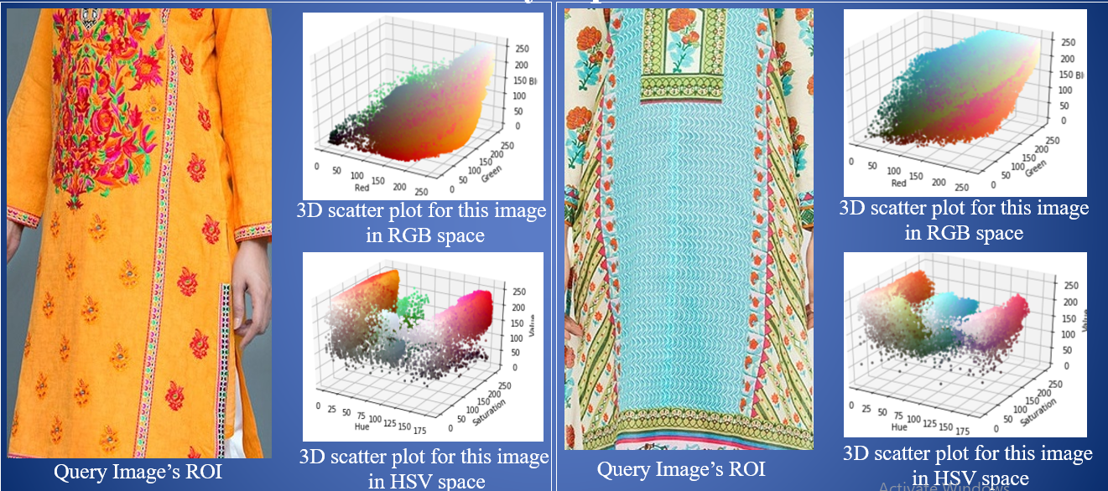
In HSV space, the pixel’s color are much more localized and Visually Separable

Slide 20
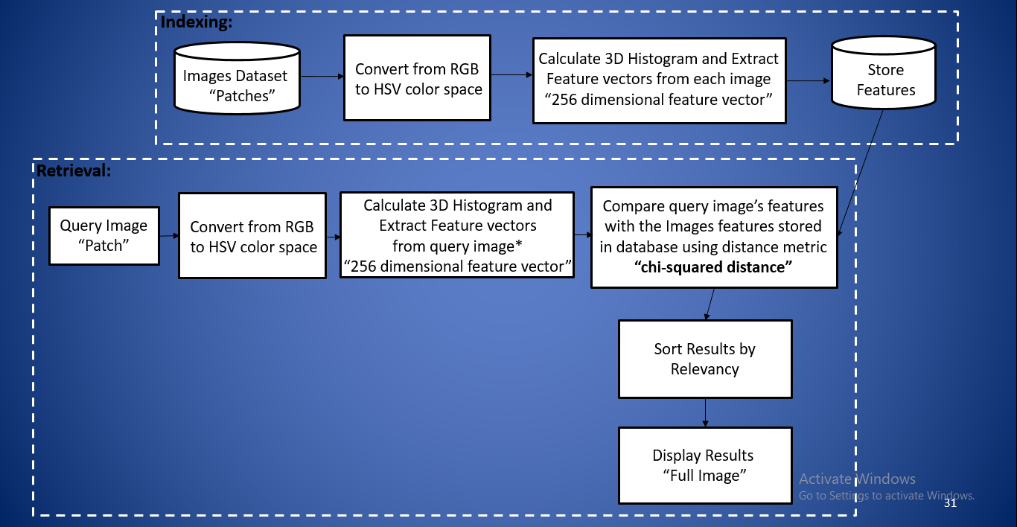
FLOW DIAGRAM OF COLOR EXTRACTION

Slide 21
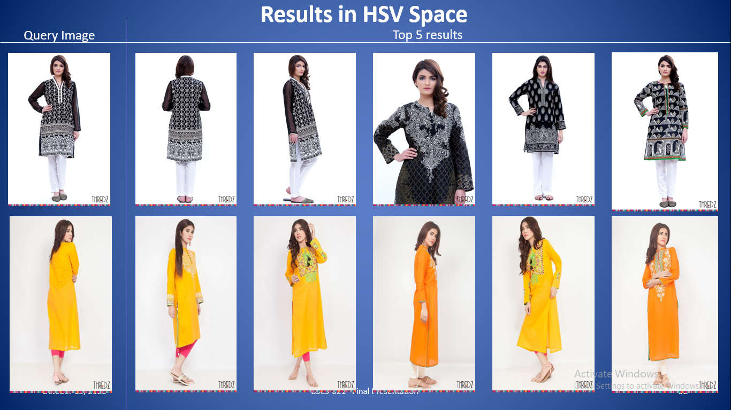

Slide 22
MODULE#3 “TEXTURE CLASSIFICATION”
Texture classification is itself a challenging task but when we talk about Pakistani culture then it is far more difficult due to extreme diversity. Most of the proposed approaches learn texture semantic by extracting low-level features from patch of an image. However, such approaches fail to take into consideration the semantic concepts that occur in the images. In this project, we focus on the high level semantic identification at the region level.
Previously, texture classification is done on the basis of some common classes like Stripes, checks, chevron, dots, plain, floral, ogee and abstract. But when we try to classify a Pakistani dresses into these classes we fail to do so because textures on Pakistani dresses is combination of these basic classes and a lot more and mostly cannot be classified in to one particular class. Let us imagine for a moment that we classify the data in these classes with success so what will be the output??. Look at the figure below.

Slide 23
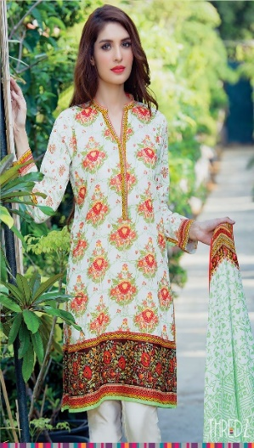
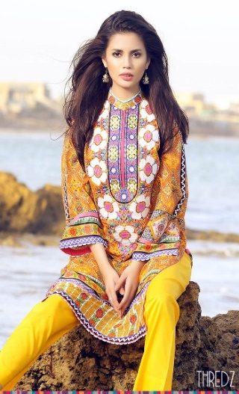
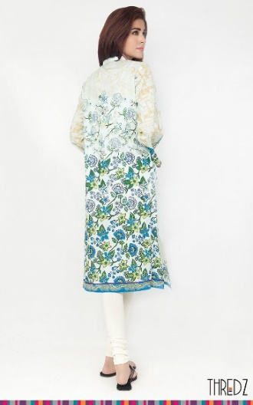
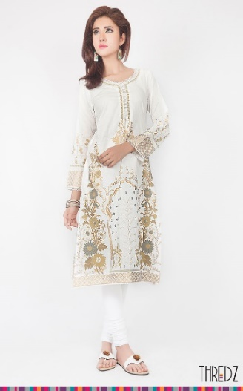
Query Image(floral) expected results (floral)
If you focused on the expected results they are floral but doesn’t look similar. Why???. The information extracted from query image was not sufficient to get satisfactory results or only classify something as floral, abstract, ogee is not sufficient.
So, we decided to tackle a problem in a different way. Most of the time we did not demand some specific texture on a dress but where the texture is, what layout texture follow attract us.
So their comes the idea of solving a problem to user point of view and classify on the basis of “Alignment of texture OR Texture composition” regardless of what texture is ,it should be where texture is. Here we justify our methodology.

Slide 24
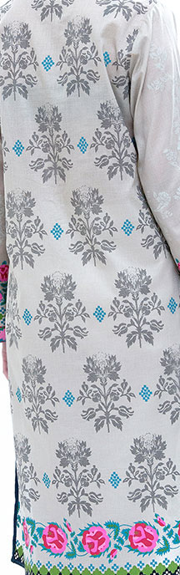
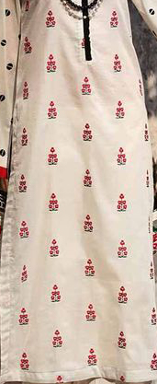
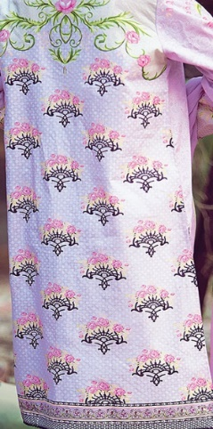
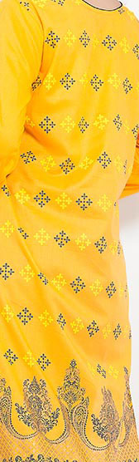
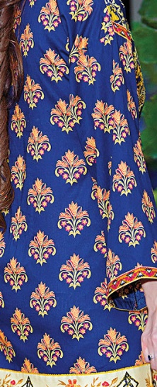
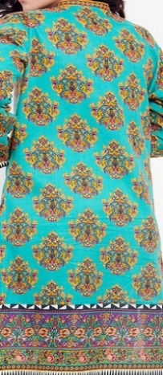
with some examples:
Look at the figure below, if we classify these images on the basis of local features they all are different and fall in different classes but if we look at them as pattern they follow they all fall under same class. Some of them are floral texture, some are geometrical and some are abstract. But all of them look visually similar due to the pattern they follow which we named as “BRICKS”.
Now observe figure bellow , Many of us like tiny texture prints fill the whole shirt or sometimes we call it as “Fully textured dress”. Here the thin texture repeat itself without any gap on whole piece of cloth regardless of what local texture it is.

Slide 25
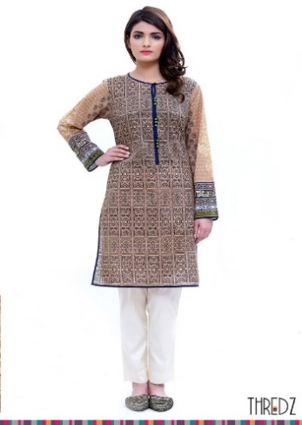
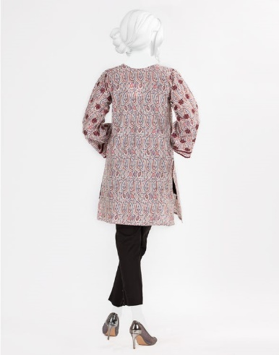
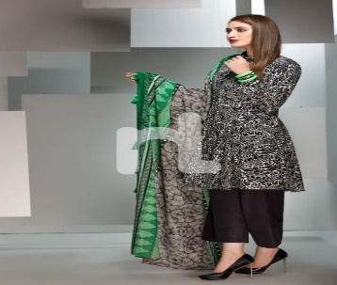
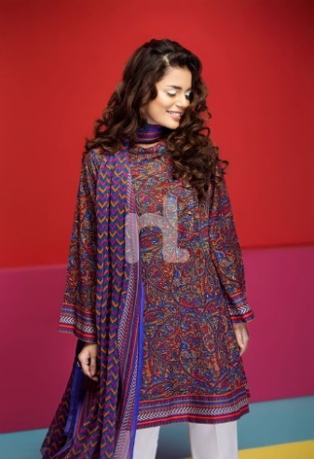
Mostly short height females searching for a textures either on top or bottom so that it can be cut from one side to properly. Look at figure below. All these images are locally vary different but semantically they are similar. This type of dresses were typecast as “bottom only textured” and “top only textured”.

Slide 26
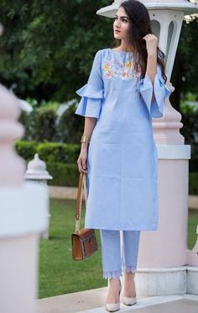
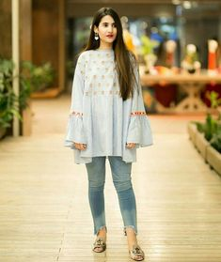
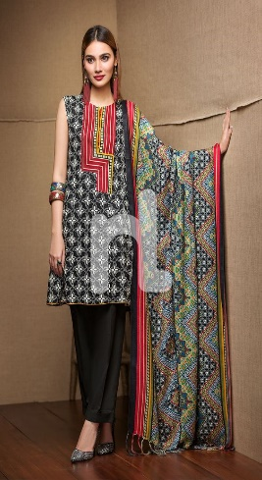
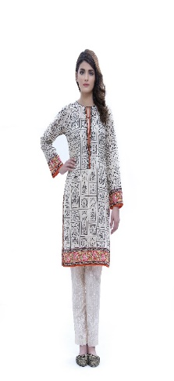
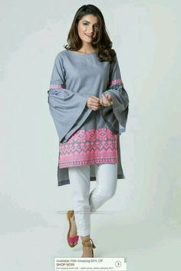
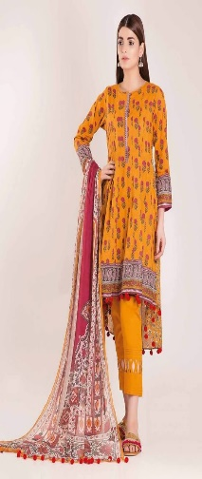
Nowadays arrangement of texture in a bunch on any side of a shirt is also very popular among people. Dresses in figure below are some examples of texture in bunch which look so elegant and people may search for this type of textured dresses. These type of dresses are further divided into three categories. Figure 18 shows texture on one side of neck and the opposite side of bottom which is named as “cross textured”, Figure 19 shows texture on only one side of shirt named as “one sided texture” , figure 20 shows the textures on both sides of shirt which is named as “both sided texture”.

Slide 27
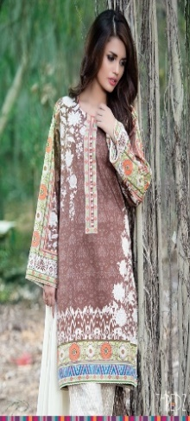
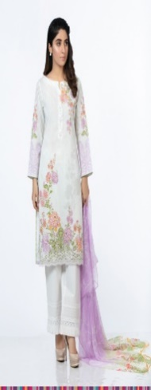
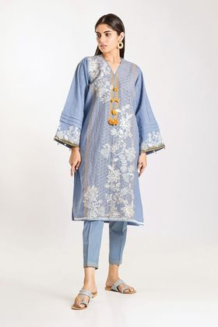
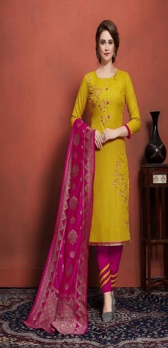
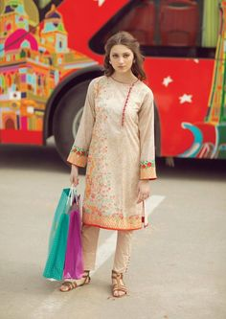
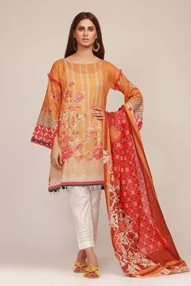
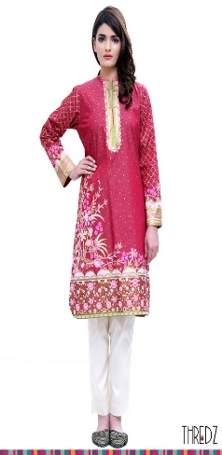
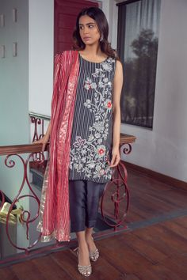
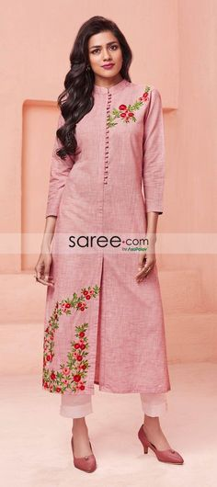
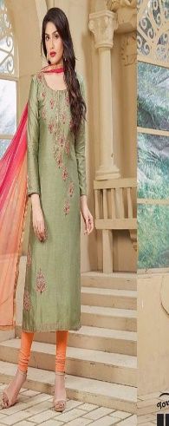
Cross textured
One Sided Texture

Slide 28
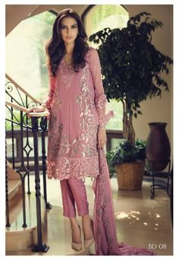



both sided texture
Panel shirt styles are very common nowadays in which the texture is divided in three or four panels. This type of dresses have extremely large variety in textures and to differentiate them and classifying them on the basis of local feature is not possible. On the other hand, they look similar due to three or four panels of textures. Hence these type of dresses were categorize as “Panel”. Figure below show some sample images of class panel.

Slide 29




Panel shirts
Above are few classes that we defined and there are more others classes like:
Centrally textured,
Geometrical textures,
Neck bottom textured and plain.

Slide 30
What Model Should Be Used For Texture Classification??
For texture classification “MobileNetV2” is used.
MobileNets are small, low-latency, low-power models parameterized to meet the resource constraints of a variety of use cases. According to the research paper, MobileNetV2 improves the state-of-the-art performance of mobile models on multiple tasks and benchmarks as well as across a spectrum of different model sizes.
This project has three Modules out of which two are working properly with good results. Due to limited data, we have not reached to any conclusion. So, our future work is to collect data for Texture Classification , so that we can complete our Search Engine.

Slide 31


Results Test CASE # 1:

Slide 32






TEST CASE # 1:
Possible Outcomes

Slide 33


Results Test CASE # 2:

Slide 34





TEST CASE # 2:
Possible Outcomes

Slide 35


Results Test CASE # 3

Slide 36






TEST CASE # 3:
Possible Outcomes:

Slide 37

GUI Model

Slide 38


Slide 39


Slide 40


Slide 41


Slide 42
Thank
You!

